Slide 1
AR/VR Companies

Slide 2
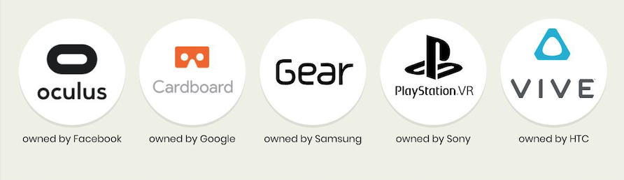
Some Popular VR Brands
source

Slide 3
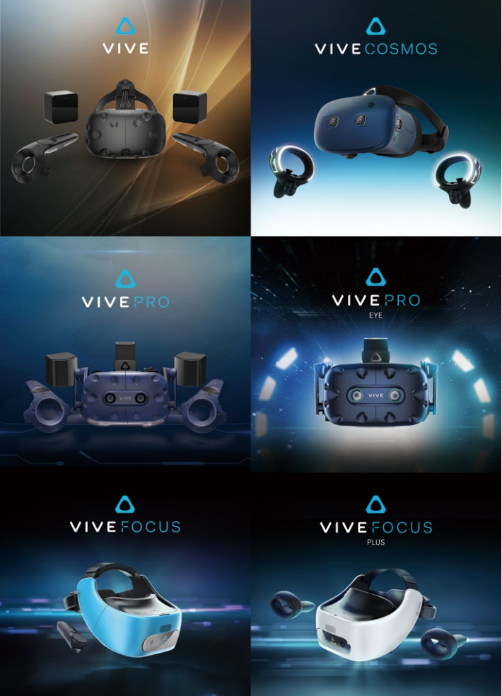
HTC Vive by HTC
Introduced for the first time February 2016 and become the new benchmark of VR products.
January 2018 business cooperation with Google Inc ($1Billion to HTC)
In 2018 Contributed to net income NT$12.0 Billion (51% from total), EPS NT$14,72
*data and image based on HTC 2018 Annual Report

Slide 4
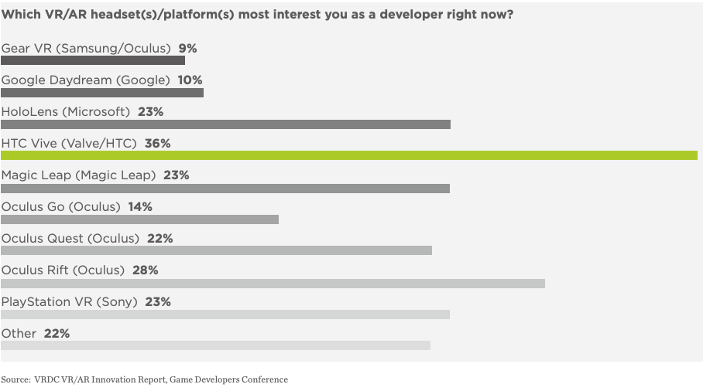

Slide 5
Oculus by Facebook
Facebook has pumped billions into VR
$100 Million in Revenue
20% (contributed by users spending on content)

